Slide 1
A note about yesterday’s robotics: Even if you are not an SME student, we will find a way through the SME Virtual Network to get you involved.
There is a list for long-term SME Virtual Network projects (many of which will use Python heavily if not completely). Any SME student or professional can be project lead if they want. The repo is here: http://bit.ly/2FlcOxG.
There is a new Jupyter project that was just released in beta – JupyterLab (an “enhancement” of Jupyter Notebooks). We will look at that option. A pretty good blog post on JupyterLab is here: http://bit.ly/2odWyoi.
If you have any feedback on how to improve this workshop or future workshops in the future, feel free to leave a comment on GitHub here: http://bit.ly/2FdmxCZ. (You can also use the other feedback methods also).

Slide 2
All SME Virtual Network projects will support labels on issues.
You can “claim” an issue by adding a comment to the issue which contains the word claim.
Want a list of other “beginner-friendly” Python open-source projects? http://bit.ly/2Fb2KUM

Slide 3
Python Virtual Environments

Slide 4
TensorFlow Playground

Slide 5
TensorFlow Playground

Slide 6








Anaconda Ecosystem
Anaconda Cloud
conda install -c <channel> <package name>
Anaconda
Python Interpreter
Applications
Libraries

Slide 7
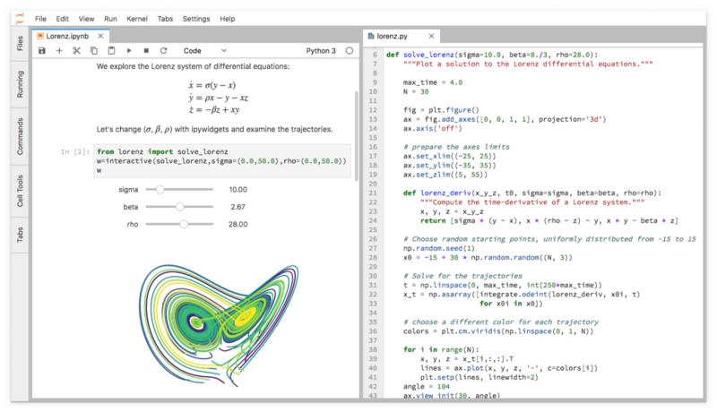
JupyterLab
Install JupyterLab into your Anaconda install: conda install –c conda-forge jupyterlab The actual Anaconda Cloud entry is here: http://bit.ly/2Facu5r

Slide 8
JupyterLab

Slide 9
Google Colaboratory

Slide 10
Today’s Agenda
A brief look at the new JupyterLab browser-based IDE.
A quick look at the ‘Model a CNC Machine Tool’ sample: http://bit.ly/2GZTBPe
REST API Example in Django (https://www.djangoproject.com). A really good library for this is Django REST Framework.

Slide 11
IIoT Fundamentals and Applications (Public Webinar)
Tuesday, March 20, 2018 11:00 am CST (12:00 pm EST) | http://bit.ly/2oEX9Qe
Tuesday, March 20, 2018 6:00 pm CST (7:00 pm EST) | http://bit.ly/2oOrNpH
Python Fundamentals for Engineers and Manufacturers (SME members-only Workshop)
Wednesday, March 28, 2018 through Friday, March 30, 2018 11:00 am CST (12:00 pm EST) each day | http://bit.ly/2oOT8I3
How to Get Your Product Manufactured (Public Webinar)
Tuesday, April 17, 2018 6:00 pm CST (7:00 pm EST) | http://bit.ly/2oHmuct
Introduction to Machine Vision (Public Webinar)
Tuesday, May 15, 2018 11:00 am CST (12:00 pm EST) | http://bit.ly/2H3kqBY
Tuesday, May 15, 2018 6:00 pm CST (7:00 pm EST) | http://bit.ly/2CVYYN3

